Slide 1
RAJALAKSHMI ENGINEERING COLLEGE OCS1903 - Programming using Python
Strings
Week-5
Notes:
arvijayakumar

Slide 2
CONTENTS
String-Data Structure
String Creation
String Indexing
String Operators
String Functions
String Methods
Problem Solving

Slide 3

String
Eg :”Vijaya Kumar“
‘rec’
String is defined as a sequence of characters.
String can contain alphabets, numbers and special characters.
String is either enclosed within “ “(double quotes) or ‘ ‘(single quotes)
Strings are immutable in nature-characters of a string cannot be modified.
Characters of a String can be accessed by their index.
Strings are immutable

Slide 4
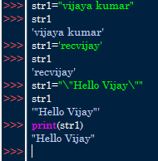
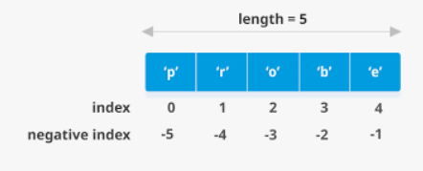
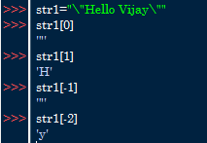

String Creation
String Indexing

Slide 5
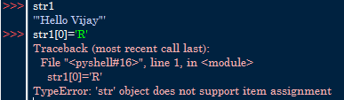
Strings are Immutable
Since Strings are immutable , characters cannot be modified
Example
OUTPUT

Slide 6
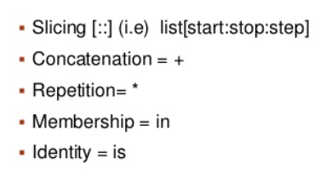
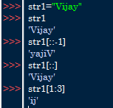
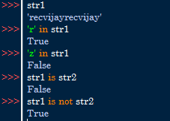


String Operators
Slicing
Membership and identity
Concatenation
Repetition

Slide 7

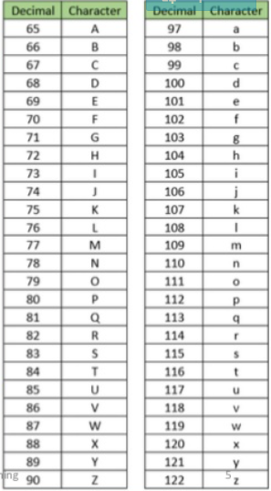
‘s’ is different from ‘S’????
ASCII VALUE
Each and every character in a string is associated with a decimal value(alphabets, integer and special characters)

Slide 8
String :Built-in Methods
Case conversion methods
Find and Replace Methods
Character classification methods
String Formatting Methods

Slide 9
Case conversion methods
Methods in this group perform case conversion on the target string.
s.capitalize() returns a copy of s with the first character converted to uppercase and all other characters converted to lowercase
s.lower() returns a copy of s with all alphabetic characters converted to lowercase
s.swapcase() returns a copy of s with uppercase alphabetic characters converted to lowercase and vice versa
s.upper() returns a copy of s with all alphabetic characters converted to uppercase

Slide 10
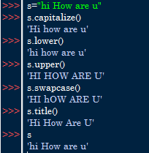
Case conversion methods
Methods in this group perform case conversion on the target string.
Original string is not modified new strings are created

Slide 11
Find methods
These methods provide various means of searching the target string for a specified substring.
count(substring ,start , end):Counts occurrences of a substring in the target string
endswith (substring ,start , end) :Determines whether the target string ends with a given substring.
find (substring ,start , end): Searches the target string for a given substring.
rfind (substring ,start , end) :Searches the target string for a given substring starting at the end.
startswith(substring ,start , end): Determines whether the target string starts with a given substring.

Slide 12
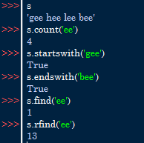
Find methods
These methods provide various means of searching the target string for a specified substring.

Slide 13
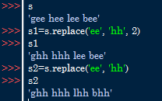
Replace method
s.replace(old , new , count): Replaces occurrences of a substring within a string and returns a new string.

Slide 14
Character classification methods
Methods in this group classify a string based on the characters it contains.
isalnum(): Determines whether the target string consists of alphanumeric characters.
isalpha():Determines whether the target string consists of alphabetic characters.
isdigit():Determines whether the target string consists of digit characters.
islower():Determines whether the target string’s alphabetic characters are lowercase.
isspace():Determines whether the target string consists of whitespace characters.
isupper():Determines whether the target string’s alphabetic characters are uppercase.
istitle():Determines whether the target string is title cased.
center():Method will center align the string, using a specified character (space is default) as the fill character.

Slide 15
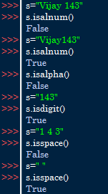


Character classification methods
Methods in this group classify a string based on the characters it contains.

Slide 16
String formatting methods
Methods in this group modify or enhance the format of a string.
Refer the below url,
https://realpython.com/python-strings/#specifying-a-stride-in-a-string-slice

Slide 17

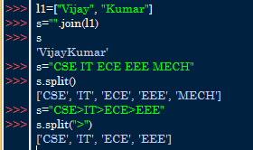
Conversion between string and list
Methods in this group convert between a string and some composite data type by either pasting objects together to make a string, or by breaking a string up into pieces.
join(<iterable>)
Concatenates strings from an iterable.
split(delimeter)
Splits a string into a list of substrings.
join(<iterable>)
Concatenates strings from an iterable.

Slide 18
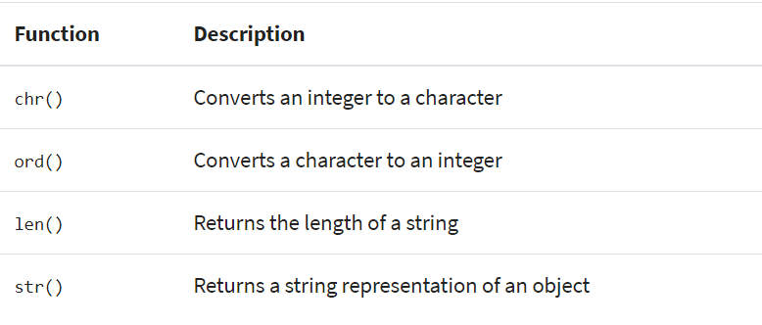

Build in functions

Slide 19
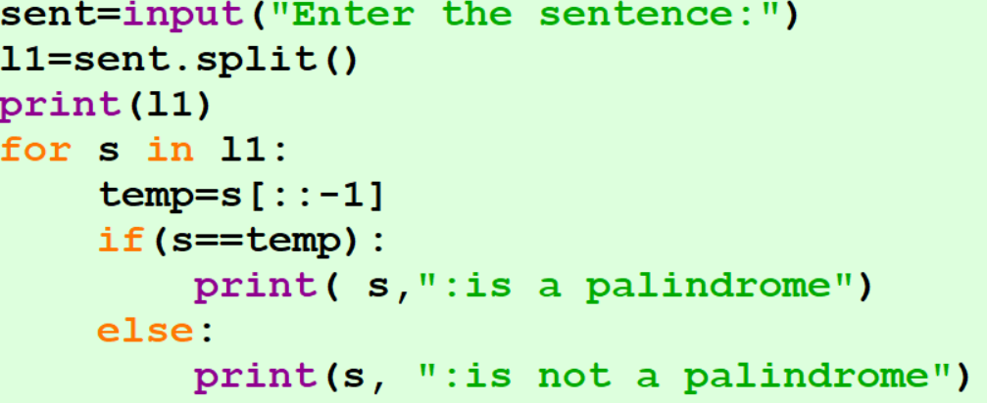
Write a Python program that takes a complete sentence as an input and find whether each word is a palindrome or not.
Example 1
Input:
“My mom and dad speak malayalam”
Output:
My: not palindrome
Mom: palindrome
and: not palindrome
speak: not palindrome
malayalam : palindrome

Slide 20
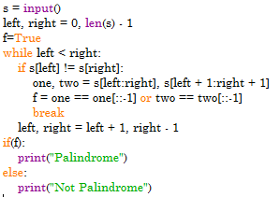
Write a Python program that takes a String as an input and find whether the word is a palindrome or not after removing maximum of one character.
Example 2
Input:
“abca”
Output:
Palindrome
Input:
”abc”
Output:
Not Palindrome

Slide 21
Robot Return to Origin
Example 3
There is a robot starting at the position (0, 0), the origin, on a 2D plane. Given a sequence of its moves, judge if this robot ends up at (0, 0) after it completes its moves.
You are given a string moves that represents the move sequence of the robot where moves[i] represents its ith move. Valid moves are 'R' (right), 'L' (left), 'U' (up), and 'D' (down).
Return true if the robot returns to the origin after it finishes all of its moves, or false otherwise.
Note: The way that the robot is "facing" is irrelevant. 'R' will always make the robot move to the right once, 'L' will always make it move left, etc. Also, assume that the magnitude of the robot's movement is the same for each move.

Slide 22

Robot Return to Origin
Example 3(COND)
Example-1:
Input: moves = "UD"
Output: true
Explanation: The robot moves up once, and then down once. All moves have the same magnitude, so it ended up at the origin where it started. Therefore, we return true.
Example-2:
Input: moves = “LL"
Output: false
Explanation: The robot moves left twice. It ends up two "moves" to the left of the origin. We return false because it is not at the origin at the end of its moves.

Slide 23

Rotate String
Example 4
Given two strings s and goal, PRINT true if and only if s can become goal after some number of shifts on s.
A shift on s consists of moving the leftmost character of s to the rightmost position.
For example, if s = "abcde", then it will be "bcdea" after one shift.
INPUT: s = "abcde", goal = "cdeab“
OUTPUT: true
INPUT: s = "abcde", goal = "abced"
OUTPUT: false

Slide 24
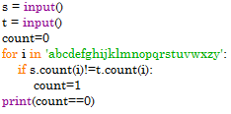
Valid Anagram
Example 5
Given two strings s and t, Print true if t is an anagram of s, and false otherwise.
An Anagram is a word or phrase formed by rearranging the letters of a different word or phrase, typically using all the original letters exactly
INPUT: s = "anagram", t = "nagaram“
OUTPUT: true
INPUT: s = "rat", t = "car“
OUTPUT: false

Slide 25


